Slide 1

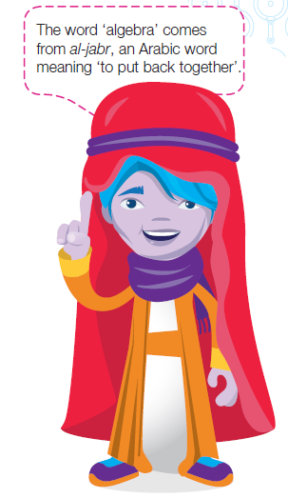
Topic: Finding a Formula From a Table
EQ: How can we build a formula from a table?
Mrs. McLeod

Slide 2

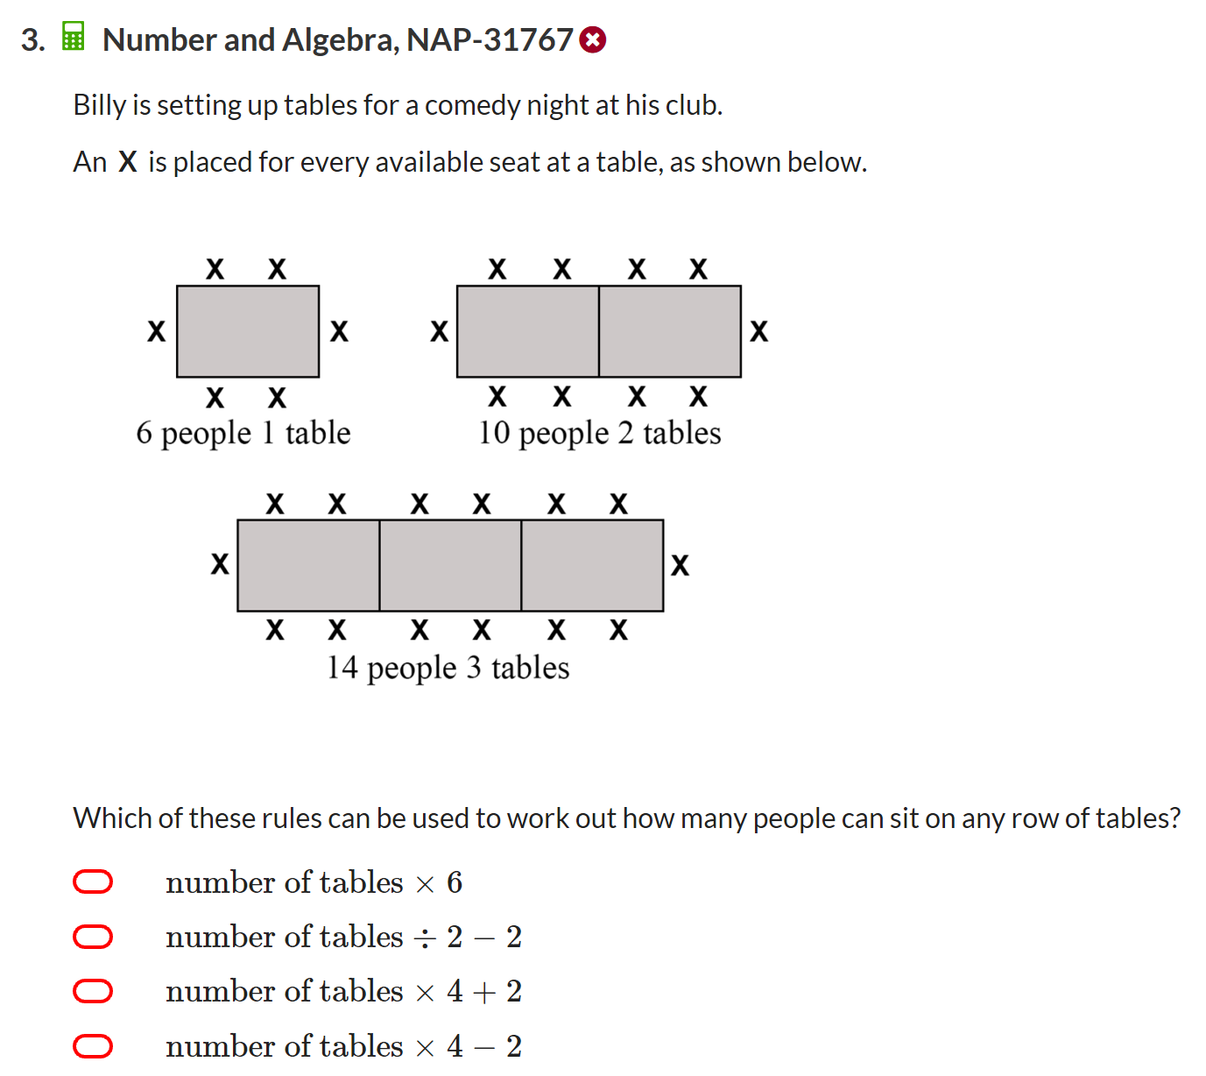
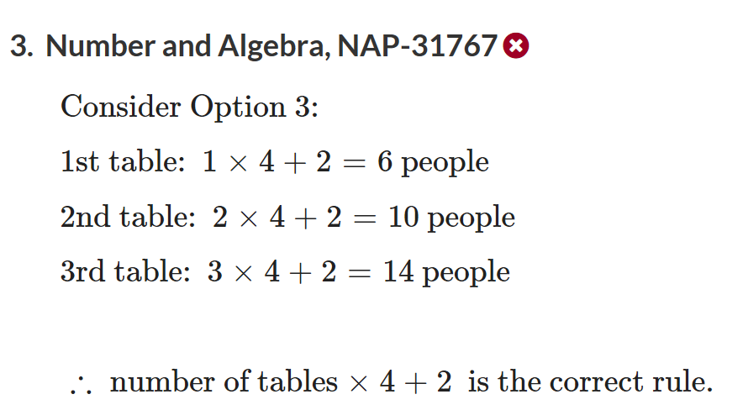

Slide 3
How would a mathematician write this?

Slide 4
24
7
30
Topic:
Date
Finding a Formula From a Table
EQ:
How can we build a formula from a table?
Example 1
X (input) | 1 | 2 | 3 | 4
Y (output) | 5 | 10 | 15 | 20
+5
+5
+5
How to find the rule
Find the difference for each step
If the difference is the same for each step then it is the same as multiplying by that number
Check it
1 × 5 = 5
2 × 5 = 10
3 × 5 = 15
(output) = (input) × 5
but since we are calling (input) x and (output) y we can write the formula as
y = x × 5 or y = 5x
Writing the formula

Slide 5
24
7
30
Topic:
Date
Finding a Formula From a Table
EQ:
How can we build a formula from a table?
Example 2
X (input) | 1 | 2 | 3 | 4
Y (output) | 7 | 12 | 17 | 22
+5
+5
+5
How to find the rule
Find the difference for each step
If the difference is the same for each step then it is the same as multiplying by that number
Check it
1 × 5 = 5 this doesn’t equal 7
What do we need to do to 5 to get to 7? +2
2 × 5 + 2 = 12
3 × 5 + 2 = 17
4 × 5 + 2 = 22
Writing the formula
(output) = (input) × 5 + 2
but since we are calling (input) x and (output) y we can write the formula as
y = x × 5 + 2 or y = 5x+2

Slide 6
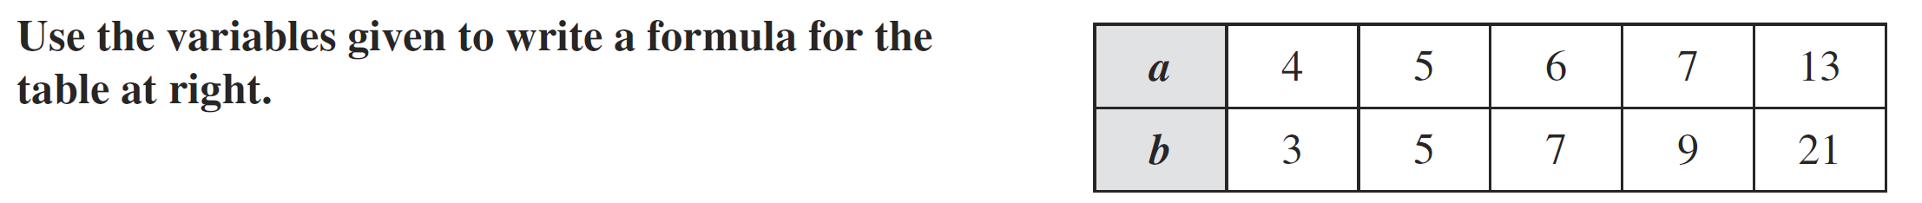

Slide 7
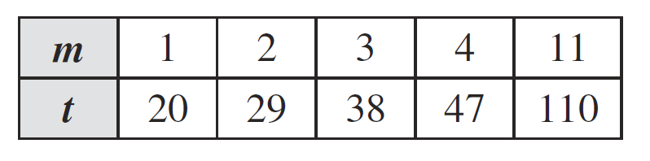

Slide 8
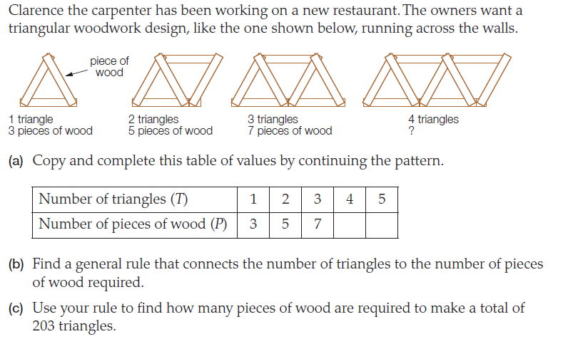
Notes:
Little bit of substitution here – will be doing this next lesson though

